Slide 1

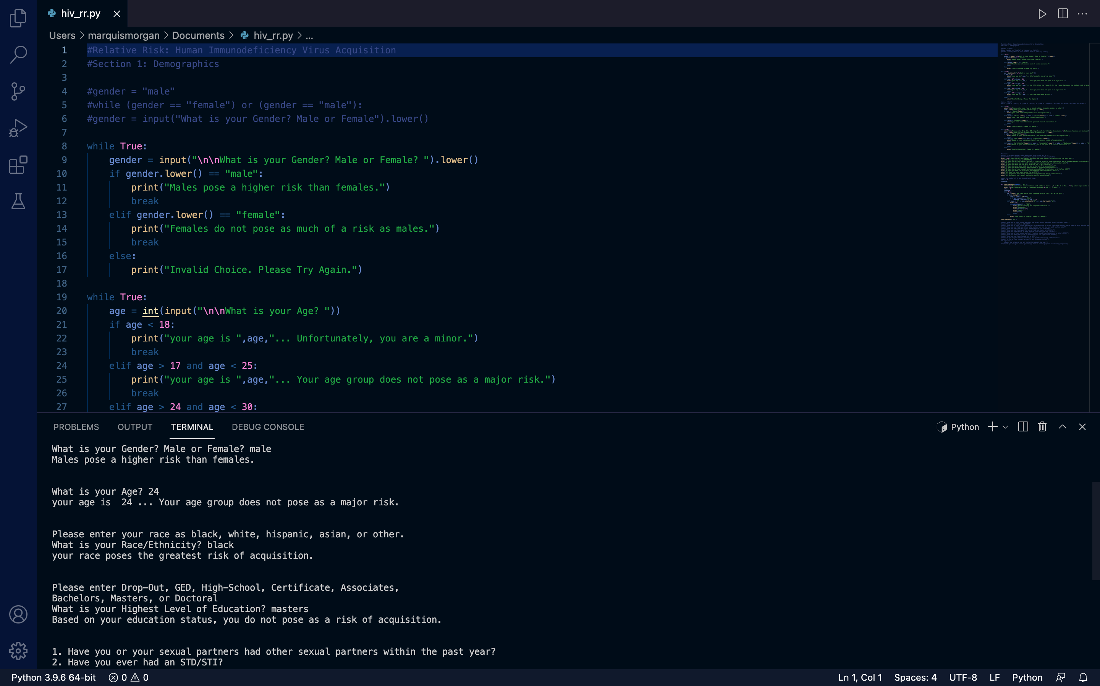
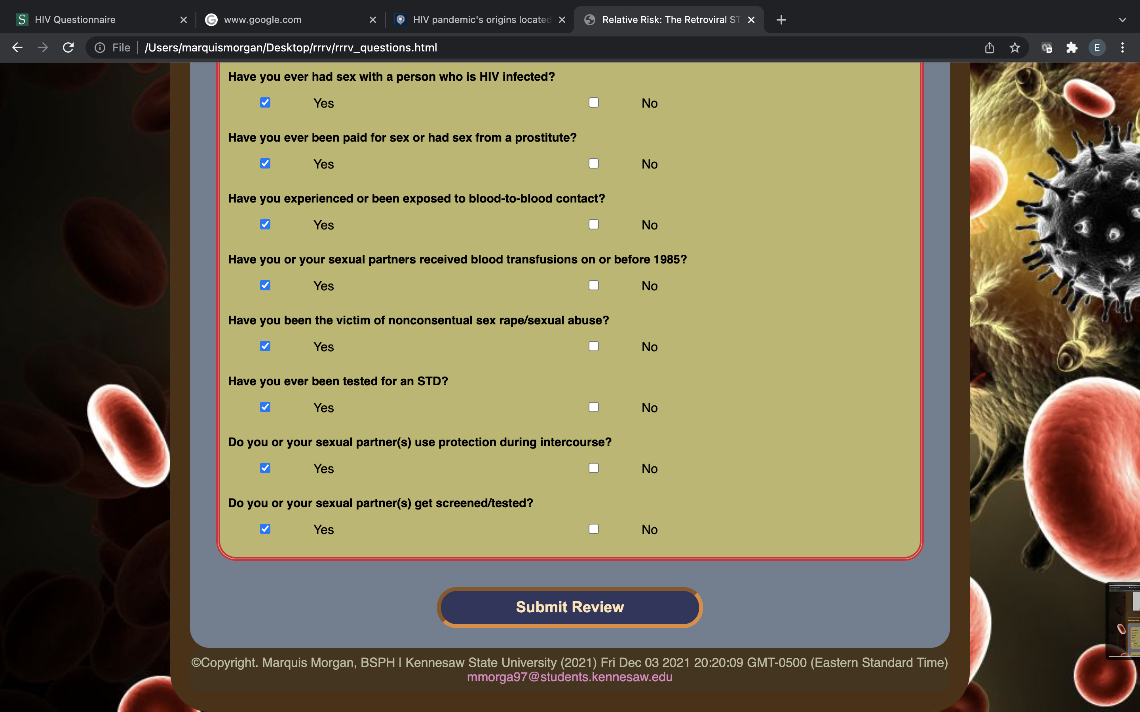
Relative Risk: The Retroviral STI
Marquis D Morgan, BSPH
https://github.com/ksu-hmi/RelativeRisk

Slide 2

Relative Risk: The Retroviral STI Members
Marquis D Morgan, BSPH
Bachelor of Science in Public Health Education and Promotion
Certified Health Education Specialist: (CHES)
CPR/First Aid Certified
Georgia Nurse Aid Registered
Bachelor of Science in Information Technology
Minor in Gerontology

Slide 3
Relative Risk: The Retroviral STI Project Links
GitHub:
https://github.com/ksu-hmi/RelativeRisk
Microsoft Teams:
https: https://teams.microsoft.com/meetingOptions/?organizerId=42e8f857-16c8-4e4c-b0fb-6354ca7e0a85&tenantId=45f26ee5-f134-439e-bc93-e6c7e33d61c2&threadId=19_c586a35357d548adb7389b21adb88334@thread.tacv2&messageId=1638891211397&language=en-US //github.com/ksu-hmi/RelativeRisk

Slide 4
Relative Risk: The Retroviral STI About/Discussion
As a Public Health Professional, we play close attention to the trends ongoing within a particular region over a period of time.
According to the CDC, there has been a gradual increase in Sexually Transmitted Infections (STIs) in the country as a whole.
System Inequalities have the greatest potential of lowering access to health and ultimately causing poorer health outcomes.
Post-COVID-19 among the South, social, cultural, and economic disparities are at an all time high making it more difficult for some populations to address pertinent issues and maintain health.
Poverty, Insufficient/Unstable Homes, Drug Use, Lack of Medical Insurance, etc.

Slide 5
Relative Risk: The Retroviral STI About/Discussion
Data shows that STI’s are … than non-Hispanic White individuals:
5-8x higher for Black/African Americans
3-5x higher for Native Americans/West Islanders
1-2x higher for Hispanic/Latin Americans
Three of Georgia’s Major cities reside in the Country’s Top 25 U.S. cities with the highest STI Rates
6. Augusta, GA… 1,400 per 100,000 HIV Cases
20. Savannah, GA… 1,696 per 100,000 HIV Cases
22. Atlanta, GA… 31,833 per 100,000 HIV cases
Based on City Population Size

Slide 6
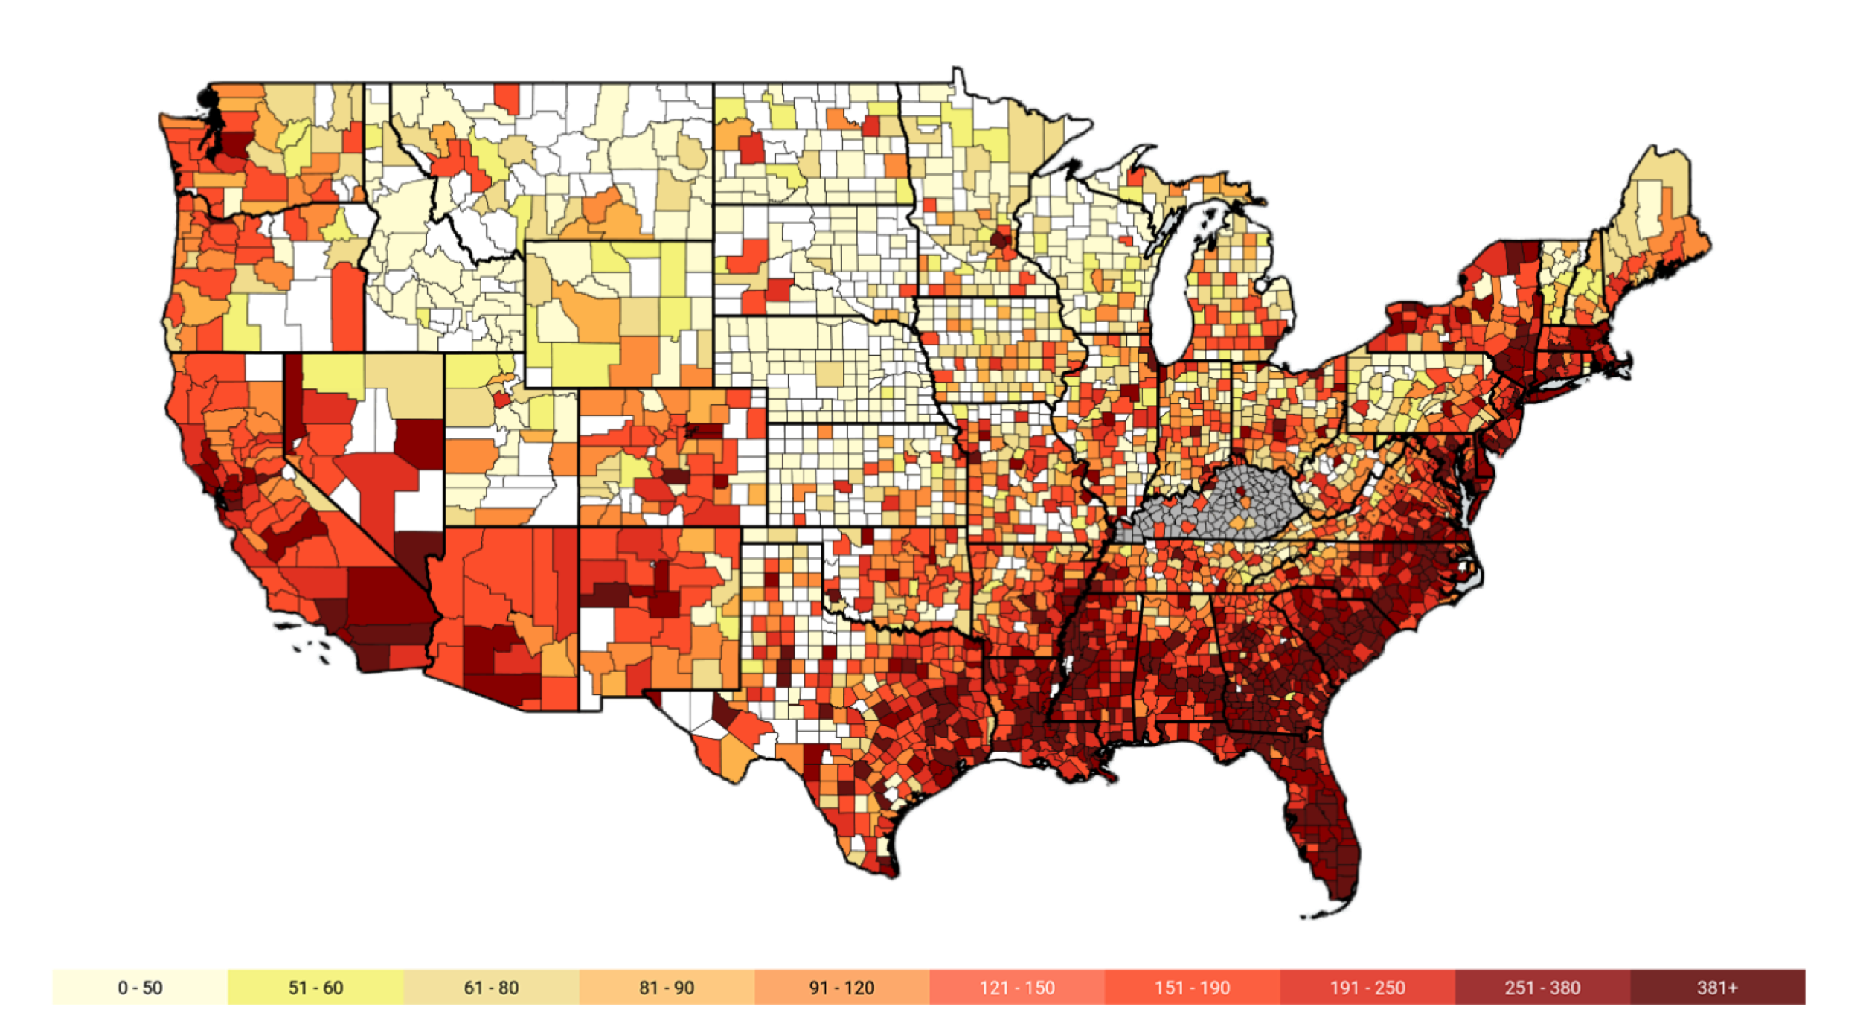
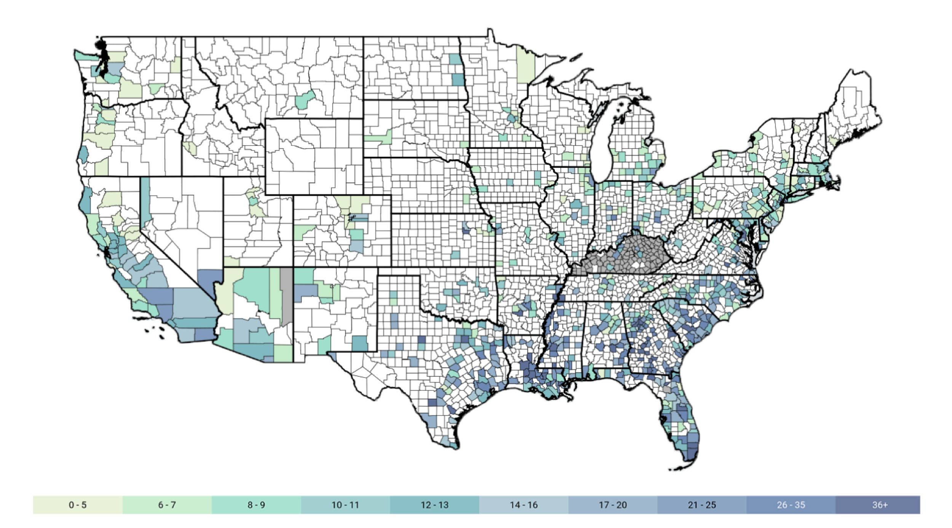
Relative Risk: The Retroviral STI About/Discussion

Slide 7
Relative Risk: The Retroviral STI About/Discussion
The objective is to allow the user to input his or her demographic information as well as a series of yes/no or t/f responses to determine if user is at risk of acquiring the sexually transmitted infection: human immunodeficiency virus based on demographics such as age, sex, education, and other social determinants of health including behaviors.
Created from scratch based off of prior assignments and similar projects based on the same topic.

Slide 8
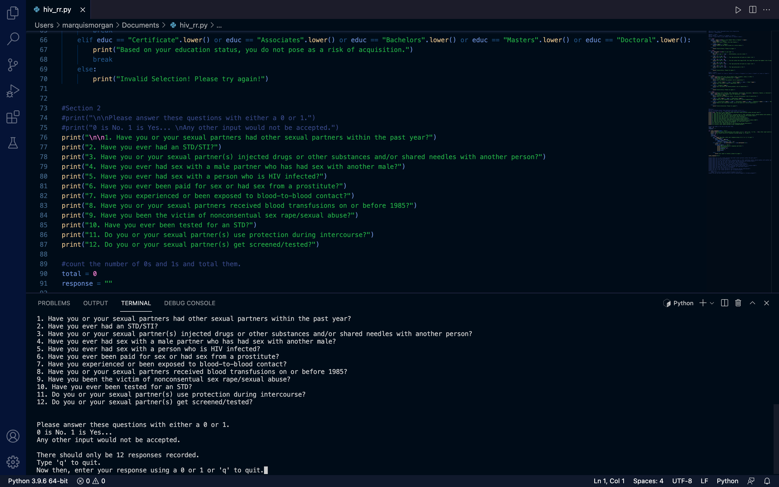
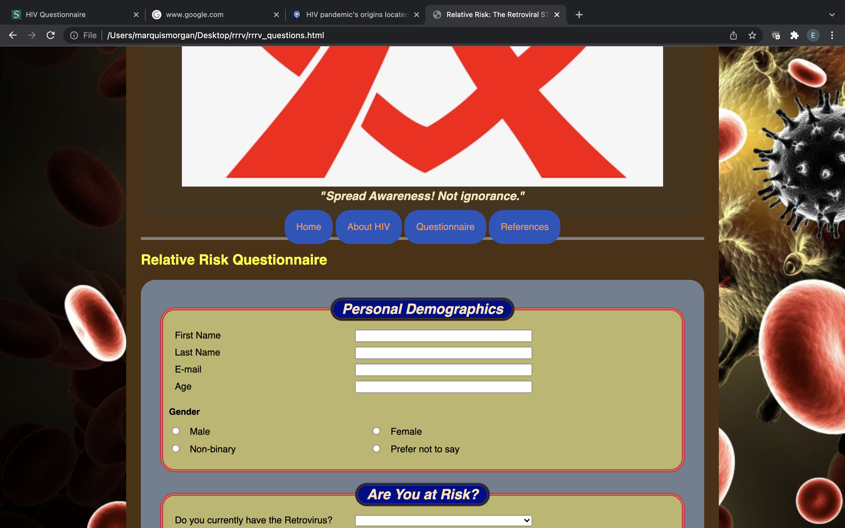
Relative Risk: The Retroviral STI The Project in the Works

Slide 9
Relative Risk: The Retroviral STI The Project in the Works

Slide 10
Relative Risk: The Retroviral STI Limitations
Limitations were centered around finding other or similar source codes for the idea.
Determining which function would be best to limit the number of user input required for the final survey.
It would take more time to critique and tailor the code into something more visually pleasing for the user.

Slide 11
Relative Risk: The Retroviral STI References
https://www.gileadhiv.com/landscape/state-of-epidemic/?utm_source=google&utm_medium=cpc&utm_campaign=USA_GO_SEM_NB_EX_GileadHIV-DTP-Facts-Stats&utm_content=Stats+-+Exact&utm_term=cdc+hiv+statistics&gclid=EAIaIQobChMI1fOhtrjG9AIVWeh3Ch37qwaXEAAYASAAEgKqUPD_BwE&gclsrc=aw.ds
https://www.skidmore.edu/health-services/education/sexual/hiv-questionnaire.php
https://www.hiv.gov/hiv-basics/overview/data-and-trends/statistics
https://www.cdc.gov/std/treatment-guidelines/clinical-risk.htm

